Slide 1


Slide 2
Introduction- AAGS
As we all know, India is famous all over the world for its great tradition and culture where women are given respect in the society since ancient times. Goddess Lakshmi, Saraswati, Parvati, Kali, Aditi show how much importance women are given in the Indian society. Indian women are found working in all fields like aeronautics, space, politics, banks, schools, sports, businesses, army, police, and many more fields. However if we introspect and think about it, we find crimes against women at home, offices as well as streets. By seeing the latest trend of crimes against women in India such as rape cases, acid attacks, etc, the safety of women has been in doubt..
Concerned because of such issues, Gauransh Arora and Akshat Gupta, two students of VIT Vellore, came up with a few ideas to overcome these social evils being socially responsible citizens.. Arpit Jain, Sai Sandeep, Gauransh Arora and Akshat Gupta together decided to counter this issue using this product…

Slide 3
How does our product work?
Footwear is something that every person wears while leaving their homes! People may forget their phones or bracelets in a hurry but no normal person would go out barefoot! This is why we chose the medium of the distress signal to be a shoe’s sole..
Whenever the victim is in danger, all the victim has to do is tap their feet so that the sensors get activated and send a distress message to our app which would send distress messages to a pre-assigned emergency contact number. Along with this, our product also sends the user’s location 24/7 to the app but when the distress signal is activated, a SOS is sent to the app!
Our product aims to stop or atleast reduce crimes against women as if a loved one is alerted and appropriate action is taken in time, the criminal can be stopped and the chances of a truly superpower India increase..
This can also be added to footwear for children which will help preventing child trafficking, kidnapping, etc.. Parents with troublesome children who keep getting lost can teach their wards how to tap their feet when they feel they are lost..
Problem Solved?

Slide 4
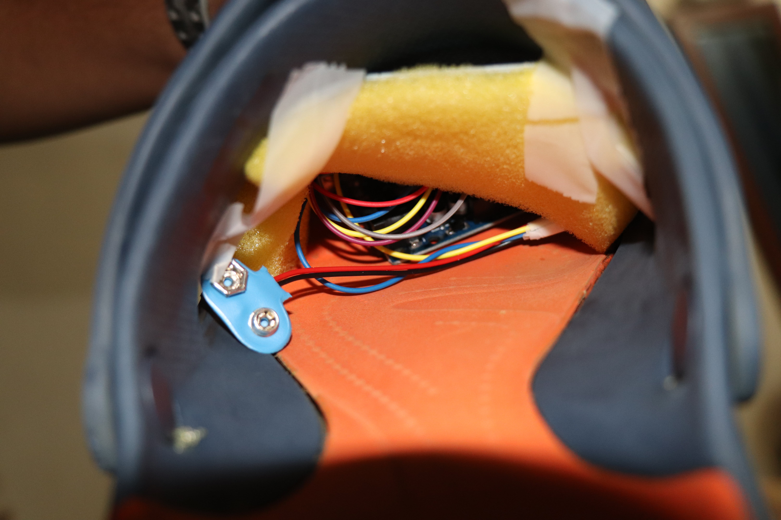

Slide 5

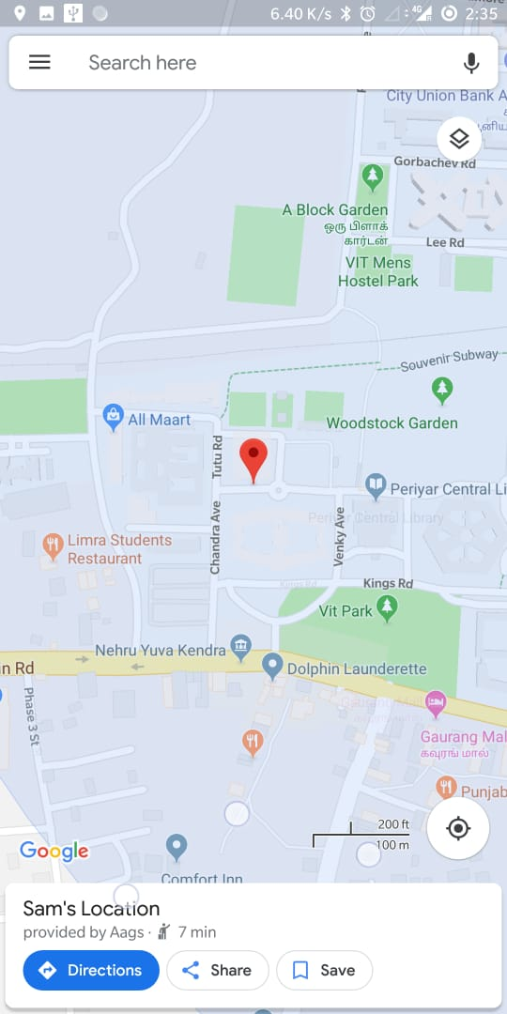
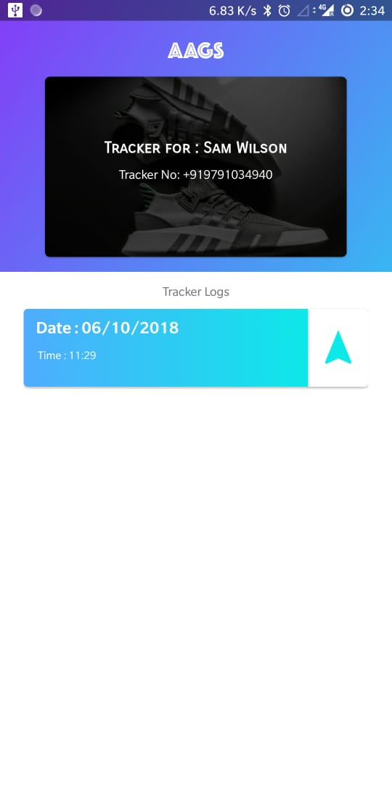

Slide 6
About us
While brainstorming for ideas for this hackathon, they decided to choose the topic Security. Akshat was talking to his mom on his phone. It was his mom’s birthday and he had gifted her a necklace. This is when Gauransh realized something that almost all women wear in common- a necklace or mangalsutra! Being a Cyber Physical Systems Researcher studying Arduino, he felt he could add sensors to the necklaces and the sensors would be able to monitor the heart rate and gather and transmit information through Real Time Communication using Voice Calls. Also when the necklace is snatched or opened by force, the sensors in the necklace would get activated and send a Voice Call to an assigned server alerting concerned authorities. Another suggestion they thought of was to create an App which would send distress calls to a pre-assigned emergency contact number. Both of them agreed to implement this idea but then Gauransh told that it had been just a few weeks since his classes started and he wouldn’t be able to monitor anyone’s heart rate with his limited knowledge. Plus he himself added that his own mother doesn’t usually wear necklaces.. This is when we decided to scrap this idea….

Slide 7
In a while, Gauransh got up to fill his bottle when his chappal suddenly broke! Then Akshat realized that Footwear is something that every person wears while leaving their homes! People may forget their phones or bracelets in a hurry but no normal person would go out barefoot! Plus it would require just simple Arduino skills as just a simple pattern or sequence of tapping the feet would activate the sensors! Gauransh agreed saying that he would able to code such a program efficiently without any problems..
The next day, they tried coding- frustrated, unable to progress, almost gave up and were on the verge of quitting when Arpit met Gauransh and told him about how they were working on projects related to App Development and Arduino respectively: the two things we needed the most for our idea to work properly…
This was when Arpit was added to the team! The rest is history- a product which can be very helpful to our society..
This is just the start and the 3 of us intend to innovate and try to come up with even better solutions to real world problems after perfecting this product..

Slide 8
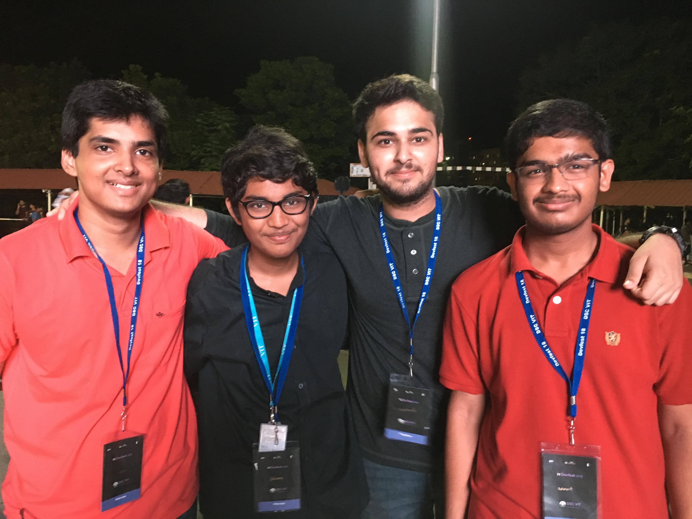
Meet the team
Arpit Jain, Sai Sandeep, Gauransh Arora, Akshat Gupta

Slide 9
contact us
Company Name: AAGS
Product Name: SmartSole
Email: aags.smartsole@gmail.com
Phone: +919600093179
Location: Vellore Institute of Technology, Vellore- 632014. Tamil Nadu, India.

